Slide 1









My Number Interactive Notebook
$$×$$
$$\frac{1}{2}$$
$$÷$$
$$+$$
$$−$$
$$\frac{3}{5}$$
$$7$$
Name
Class
Teacher
Term 1 Semester 1
$$5^{2}$$
$$\sqrt{9}$$
1

Slide 2
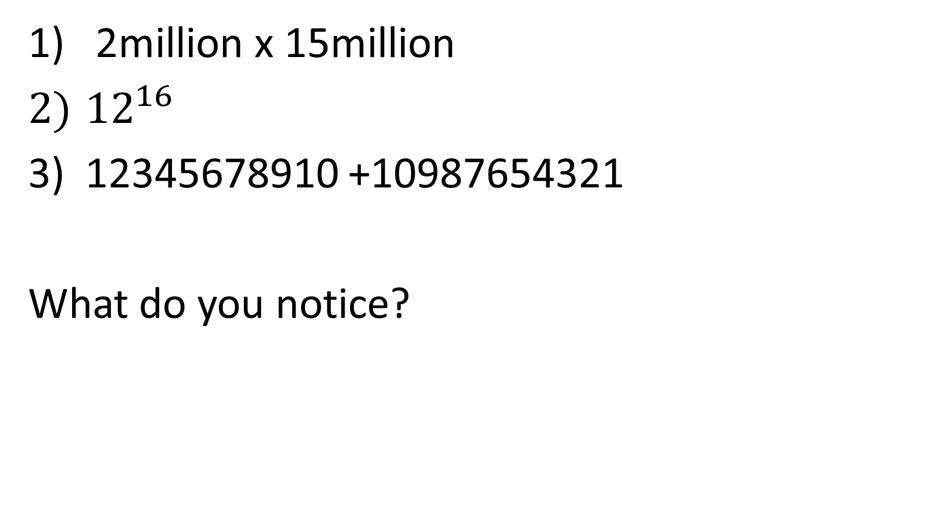
Starter – Use your calculator to find
2million x 15million
${12}^{16}$
12345678910 +10987654321
What do you notice?

Slide 3
Contents
Glossary or Formula Page
Page
Date
Description
2
3

Slide 4
Tasks
24
7
30
Essential Question
Questions
Notes
Summary
10
11

Slide 5
24
7
30
Date
Scientific Notation
EQ – How is index notation used to write very large numbers?
11

Slide 6
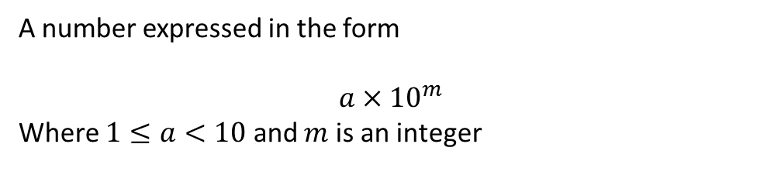
24
7
30
Date
Scientific Notation
EQ – How is index notation used to write very large numbers?
What is scientific notation?
Examples
A number expressed in the form
$$a×{10}^{m}$$
Where $1≤a<10$ and $m$ is an integer
11

Slide 7
24
7
30
Date
Scientific Notation
EQ – How is index notation used to write very large numbers?
Write 2 778 000 in scientific notation.
What is scientific notation or standard form?
Examples
A number expressed in the form
$$a×{10}^{m}$$
Where $1≤a<10$ and $m$ is an integer
11

Slide 8

24
7
30
Date
Scientific Notation
EQ – How is index notation used to write very large numbers?
Write 2 778 000 in scientific notation.
$$2.778×{10}^{6}$$
What is scientific notation or standard form?
Examples
A number expressed in the form
$$a×{10}^{m}$$
Where $1≤a<10$ and $m$ is an integer
11

Slide 9
24
7
30
Date
Scientific Notation
EQ – How is index notation used to write very large numbers?
Write 2 778 000 in scientific notation.
$$2.778×{10}^{6}$$
What is scientific notation or standard form?
Examples
A number expressed in the form
$$a×{10}^{m}$$
Where $1≤a<10$ and $m$ is an integer
The number of digits past the first digit
11

Slide 10
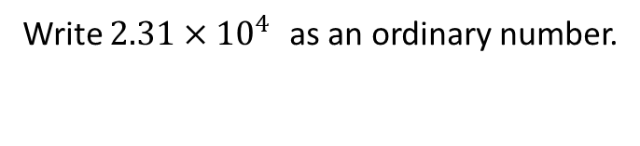

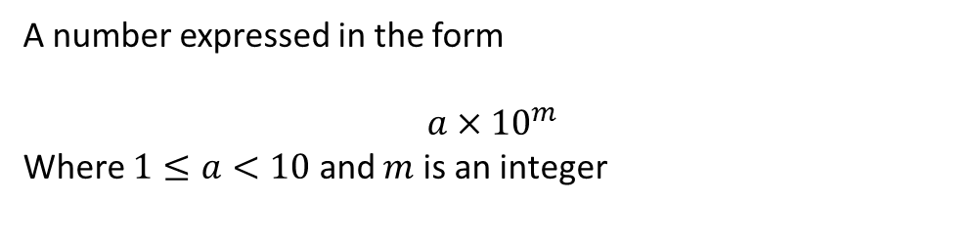
24
7
30
Date
Scientific Notation
EQ – How is index notation used to write very large numbers?
A number expressed in the form
$$a×{10}^{m}$$
Where $1≤a<10$ and $m$ is an integer
What is scientific notation or standard form?
Examples
Write 2 778 000 in scientific notation.
$$2.778×{10}^{6}$$
The number of digits past the first digit
Write $2.31×{10}^{4 }$as an ordinary number.
11

Slide 11
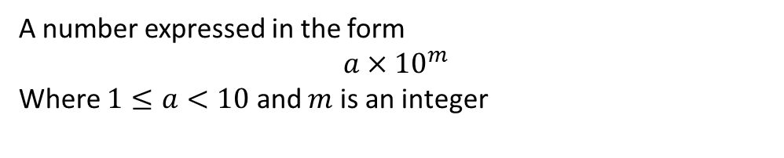
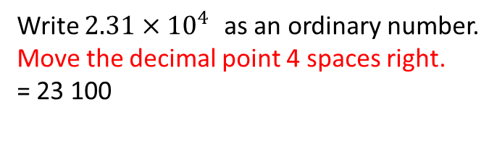
24
7
30
Date
Scientific Notation
EQ – How is index notation used to write very large numbers?
Write 2 778 000 in scientific notation.
$$2.778×{10}^{6}$$
What is scientific notation or standard form?
Examples
A number expressed in the form
$$a×{10}^{m}$$
Where $1≤a<10$ and $m$ is an integer
The number of digits past the first digit
Write $2.31×{10}^{4 }$as an ordinary number.
Move the decimal point 4 spaces right.
= 23 100
11

Slide 12
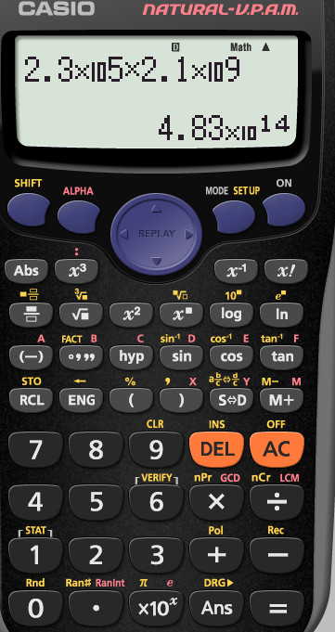
Some calculators use
EXP
Use for scientific notation

Slide 13
Textbook
Page 354 Exercise 6F
Q4 and 7

Slide 14
Notes Review
24, 7 ,30
Date
Title
Essential question
Notes complete
Notes complete with colour and diagrams
Questions completed
Contents page filed in
Formula page filled in

Slide 15
Homework
Review your notes and write a summary answering the essential question.

